Slide 1
Interface Evaluation of Quizlet
Anna Douville
November 30th, 2017
Notes:
Hi Guys My name is Anna and I evaluated Quizlet for my project.

Slide 2
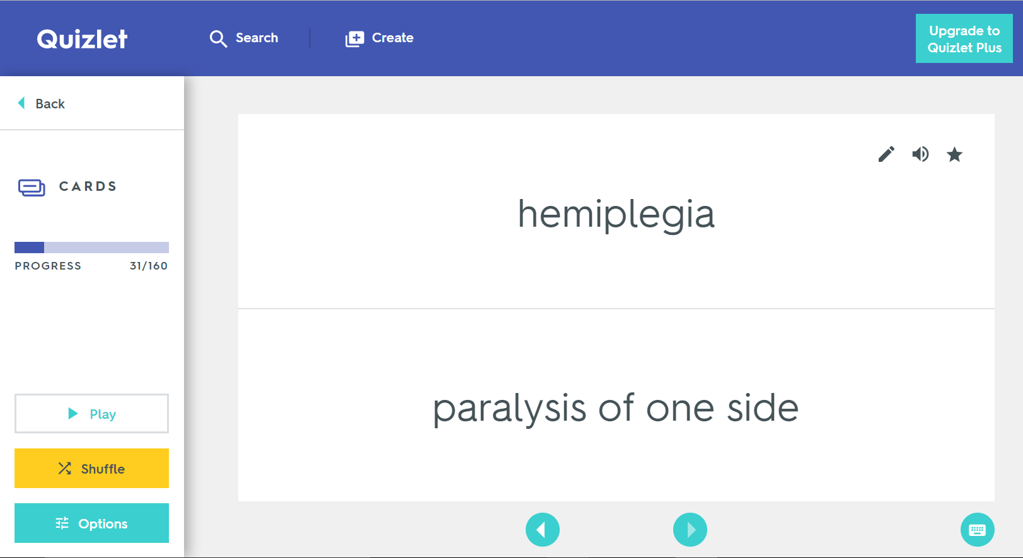

What Is Quizlet?
An interactive website that allows users to create and study virtual flashcards
7 different study tools and games designed based on principles of learning and memory
Notes:
As many of you may know, Quizlet is an interactive website that allows users to create and study virtual flashcards with 7 different tools and games. For example, users can flip through sets as they would with normal flashcards or users can answer multiple choice, fillin, or matching questions based on the cards.

Slide 3



Experienced User Interviews
Likes
Dislikes
- Easy to use
- Accessible
- Tools are helpful for memorization
- Can study other user’s flashcards
- Saves time and money compared to physical flashcards
- The games tools are not fun
- Limited to vocabulary-based learning
- Can’t input equations
- Can’t color-code flashcards
- Does not accept multiple forms of a word when typing in answers
3 Main User Tasks:
1. Creating a set of flashcards
2. Studying Flashcards with the “Learn” tool
3. Searching for other users’ flashcards
Notes:
In the experienced User Interviews, I discovered that users tend to like quizlet because it is helpful for studying, easy to use, it can be accessed from multiple devices, and users can study other users’ study sets. Participants did not like quizlet because the games aren’t very fun and quizlet is mainly limited to vocabulary-based learning, so it can’t be used with all classes. Participants’ top uses of quizlet are creating a set of flashcards, studying flashcards with the “Learn” tool, and searching for other users’ flashcards.

Slide 4



Usability Testing
Task 1: Create a study set
Task 2: Study the study set with “Learn”
Task 3: Search for other study sets
Entering terms and definitions was intuitive
“Learn” tool was intuitive
Positive feedback (happy face emoji) from a right answer was encouraging
No errors were made by any participant
The search results using the “Classes” feature were better than expected
Users struggled to find the initial create button
Users were confused by the loading page
Users were confused by having to press the create button twice
Users made 5 errors total
Negative feedback (half-frowny face emoji) from a wrong answer was demotivating
Participants struggled to find the search bar
Users made 9 errors total
Notes:
In the usability testing interviews, all participants were able to complete all three tasks with relative ease. In the first task where participants made a set of 5 flashcards, they commented that entering terms and definitions was intuitive, but they struggled with efficiently finding the right buttons on the screen. Some participants were also confused by the loading screen and having to press the “create” button again to finish creating their set. In the second task, participants used one of the study tools to study their set of flashcards that they made. Overall, participants gave positive feedback, and made no errors using the study tool. They liked the positive feedback when they got an answer right, but thought the negative feedback was demotivating. In the 3rd task, I asked users to search for study sets related to the intro to psychology course at UCSC. Participants who used the classes feature, which filters study sets based on school and course, completed the task faster, made less errors, and found better search results than participants who directly used the search bar.

Slide 5
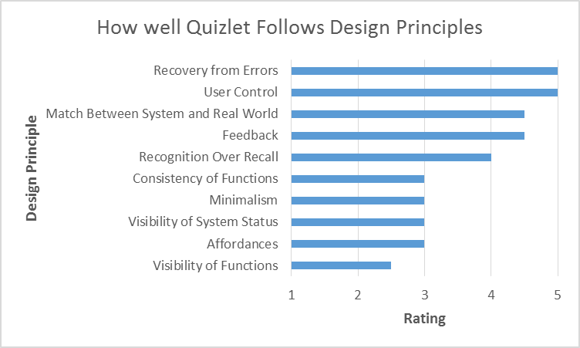

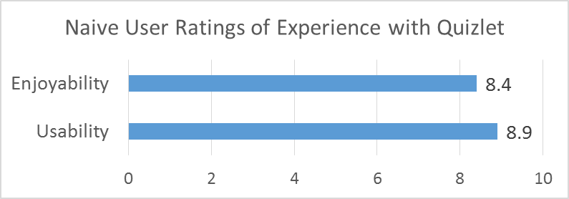
Analysis and Summary
Design Suggestions:
hi
Search and Create buttons should be bigger and more centered
Loading screens should have loading icons
Minimize number of buttons on screen
Change second “Create” button to “Finish” or ”Done”
Notes:
On average, Naïve users rated Quizlet an 8.4 out of 10 for enjoyablness and 8.9 out of 10 for usability. Based on the usability tests, Quizlet follows some design principles well, such as recovery from errors, User control, Matching, Feedback, and recognition over recall. Quizlet could improve with respect to visibility of functions by making the “Search” and “Create” buttons bigger and more centered so users can find these functions more easily. In addition, visibility of system status could be improved by displaying a loading icon so participants don’t get confused. The interface can also be more minimalistic by hiding certain functions that aren’t as important or making buttons smaller so users don’t have to scroll as much. Overall participants enjoyed using Quizlet, and were able to complete all tasks, but the design suggestions have the potential to give users an even better experience with Quizlet.

